Slide 1
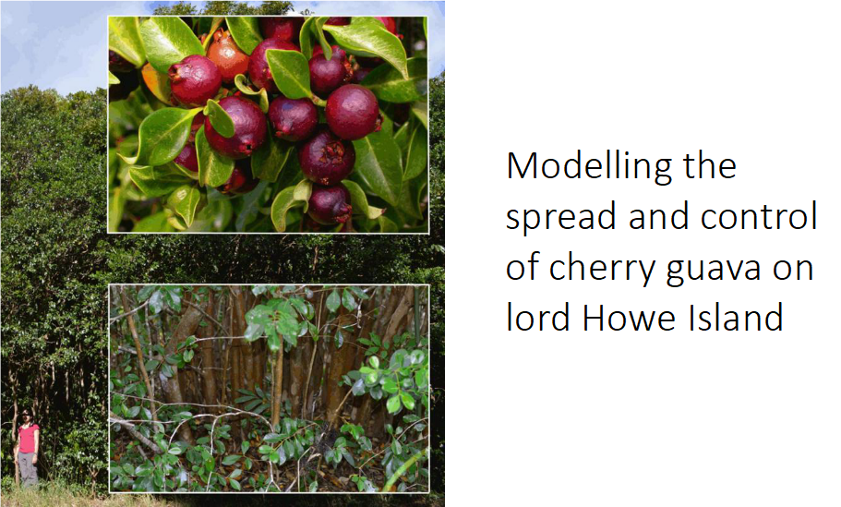
David Nwoye
Date: 16.03.2020

Slide 2
Outline
Introduction
The Problem
Matrix Model
Project Steps
Methods
R-code
Results and Discussion
Conclusion

Slide 3
Introduction
The Lord Howe Island is located on the eastern coast of Australia.
The Island consists of many unique flora and fauna species endemic to the island which are also threatened by invasive species.
Native fauna are usually at risk due to the presence of invasive species.
Invasive species have the potential to transform a specific environment to complete monocultures.
Modelling is an approach that is increasingly used to tackle the problem posed by invasive species

Slide 4
The Problem
The Lord Howe Island has over the years been threatened by both flora and fauna invasive species
The most serious threat to the Island is the cherry guava crop
Since the beginning of the weed management program, 700,000 cherry guava plants from all life stages have been removed but the cherry guava weeds are still widespread
Research aim: How much removal (per year) is needed to control the cherry guava crop?

Slide 5
Why Matrix Model?
The cherry guava plant is characterised by different life stages
Matrix models are an elegant way to handle population dynamics with different life stages (or age classes)
Calculation of important parameters (growth rate, stable stage structure)
Potential important information would be lost if a simpler model would have been chosen (~ treat all Individuals as equivalent)

Slide 6
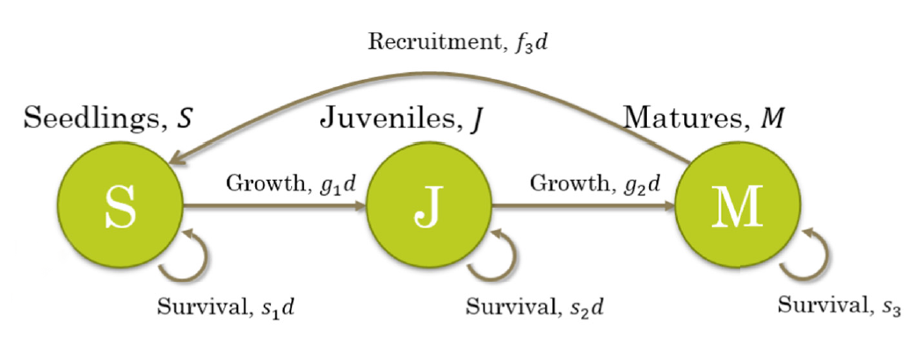
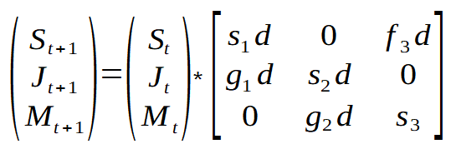
Matrix Model
Baker et al. 2018
Nt+1 = Nt * Transition Matrix (Lefkovitch-Matrix)

Slide 7
Project Steps
1.Step: Calculate the population dynamics over 25 years with the initial abundances of: Seedlings: 1000, Juveniles: 100, Matures: 10
2.Step: Calculate finite growth rate and stable stage structure
3.Step: Introduce removal of all life stages (10% and 35%)
4.Step: Add density dependence (with an area of 9 ha)
all the parameters used for this model was provided by Baker et al. 2018

Slide 8
R-code for Step 1
# Lefkovitch matrix for cherry guava
cherry_MTR = rbind(c(s1*d, 0.000, f3*d),c(g1*d, s2*d, 0.000),c(0.000, g2*d, s3))
# starting population
ini_N <- matrix(c(1000,100,10), ncol=1)
# matrix for the population development
YEARs <- 25
pop_MTR <- matrix(0,nrow=3,ncol=YEARs+1)
pop_MTR[,1] <- ini_N
# calculation of the population development over time via for-loop
for(t in 2:(YEARs+1)){
pop_MTR[,t] <- pop_MTR[,t-1] %*% cherry_MTR
}
# Parameters:
s1 <- 0.27
s2 <- 0.272
s3 <- 0.305
g1 <- 0.398
g2 <- 0.366
f3 <- 9.74
d <- 1

Slide 9
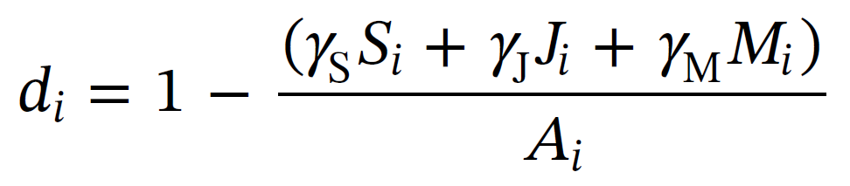
R-code for Step 2, 3 and 4
# Finite rate of exponential growth
Lambda <- as.numeric(eigen(cherry_MTR)$values[1])
# Stable stage structure
SAD <- as.numeric(eigen(cherry_MTR)$vectors[,1])
SSS <- SAD/sum(SAD)
# Introduce removal
Removal <- 0.1 # 0.35
for(t in 2:(YEARs+1)){
pop_MTR[,t] <- cherry_MTR %*% pop_MTR[,t-1] %*% (1-Removal)
}
# Add density dependency (d) parameter
for(t in 2:(YEARs+1)){
d <- 1 - ((gammaS*pop_MTR[1,t-1]+gammaJ*pop_MTR[2,t-1]+gammaM*pop_MTR[3,t-1])/A)
cherry_MTR = rbind(c(s1*d, 0.000, f3*d),c(g1*d, s2*d, 0.000),c(0.000, g2*d, s3))
pop_MTR[,t] <- cherry_MTR %*% pop_MTR[,t-1]
}
Eigenvalue of Lefkovitch matrix
Eigenvector of Lefkovitch matrix
# Parameters:
gammaS <- 8.76*10^(-5)
gammaJ <- 1.02*10^(-4)
gammaM <- 3.65*10^(-4)
A <- 9

Slide 10
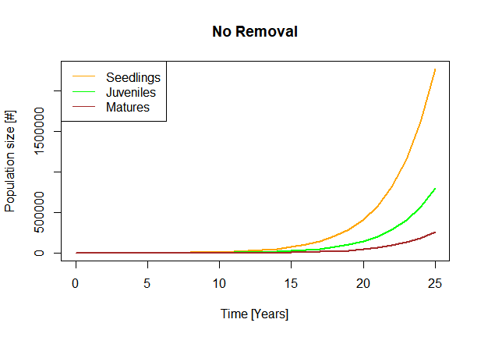
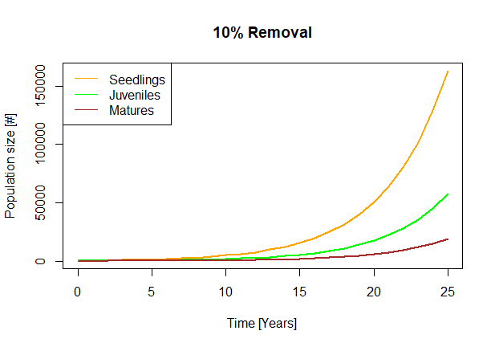
Results and Discussion

Slide 11
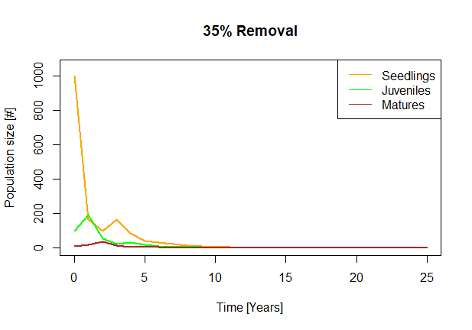
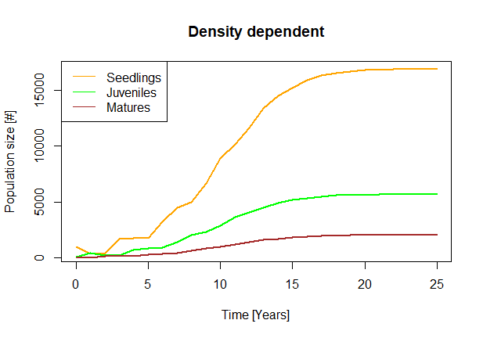
Results and Discussion

Slide 12
Results and Discussion
Finite growth rate (λ): 1.406
Stable stage structure (SSS): 0.682 0.239 0.079
Extra:
No growth at λ = 1
Removal (R) balancing the growth rate: 1.406*(1-R) = 1
R = 0.2888
Combined with initial abundances consistent with SSS (eg. 682, 239, 79)
-> no changes

Slide 13
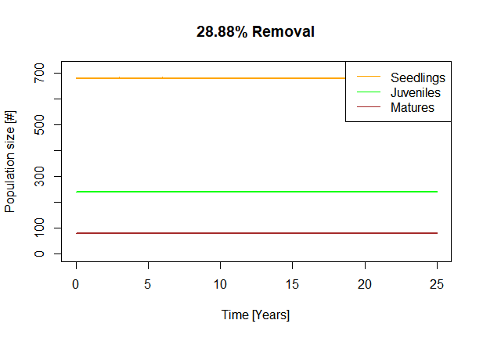
Results and Discussion

Slide 14
Conclusion
Our model predicts that a removal of 35% is enough to control the population of cherry guava in few years
Percentage increase in removal makes a huge difference in the growth

Slide 15
Thanks for Your attention! ???

